Slide 1
“Geek Out”: DIY vSphere 5.1 Lab
Hartford / CT VMware User Group
March 28th, 2013
Matt Kozloski

Slide 2
DIY vSphere Lab
Goal: vSphere Lab which can simulate all features of vSphere, such as:
HA
DRS
Distributed Virtual Switch
vMotion / Storage vMotion
Shared Storage
** (most?) Portions of this are totally not supported by VMware **
Licensing:
  VMware’s products come with 60-day eval
  TechNet Subscription makes life easier to get Windows OS’s for guests
    See DreamSpark for students

Slide 3
Two Methods
VMware Workstation
  Install on Windows or Linux
VMware vSphere 5.1
  Nested hypervisor support

Slide 4
VMware Workstation
Pro’s
Works well for laptop/workstation installations, where you aren’t “dedicating” a workstation/server to your lab
Natively does Linked Clones
NAT/DHCP is already built-in
Less complicated
Con’s
Inserting extra layer of OS, in an already lean lab
Sometimes NAT server needs to be restarted
Windows Updates not related to VMware Workstation
Not as cool as a nested hypervisor ☺

Slide 5
VMware Workstation
Install host OS (RHEL / CentOS / Windows 7 / Windows 2008 R2)
Install VMware Workstation
Copy ISO images over
Install vSphere
Install vCenter
  Consider installing vCenter outside of vSphere cluster, for accessibility reasons
Recommend at least 8-10GB of RAM
  Try using: “Fit all virtual memory in reserved host RAM” but watch for swapping of other apps

Slide 6
VMware vSphere 5.1
Pro’s
Lean install – you can install it on a USB stick and use your HDD’s for VMFS
Pure vSphere – no traditional OS between you and the hardware
Very stable
Cool to show off nested HV support to your friends and family ☺
Con’s
Requires Intel EPT or AMD RVI for 64-bit nested guests
Not “officially” supported

Slide 7
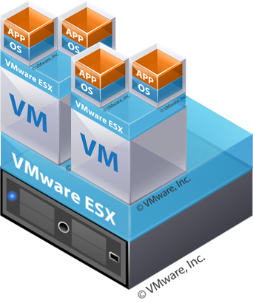
VMware vSphere 5.1
Check for Nested HV support
Configure networking
Install vSphere 5.1 on host system
  You can install it on a USB stick
Enable Nested HV support
Install ancillary items on host system
  NAT router / firewall
  “Jump” box
    Windows XP
Install vSphere VMs on host system
Create shared VMDKs
for shared storage

Slide 8
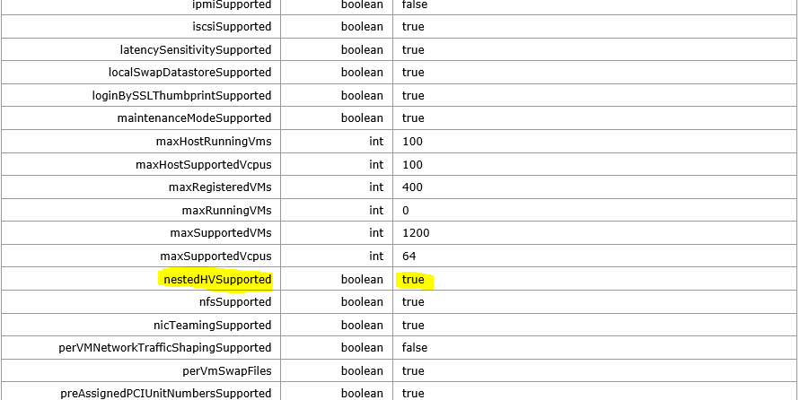
VMware vSphere 5.1
Check for Nested HV support:
https://{host IP address}/mob/?moid=ha-host&doPath=capability

Slide 9
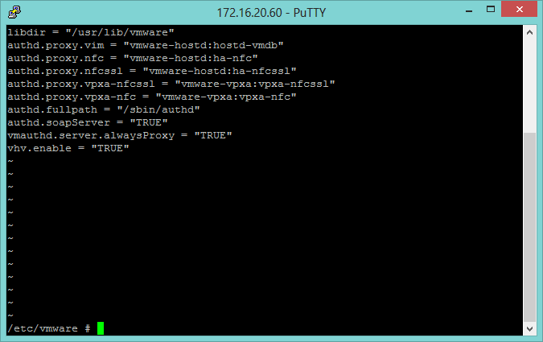

VMware vSphere 5.1
Enabled Nested HV support
  This allows you to successfully virtualize 64-bit VMs inside your nested vSphere hosts
Using your favorite text editor (vi?), add:
vhv.enable = “TRUE”
to /etc/vmware/config

Slide 10
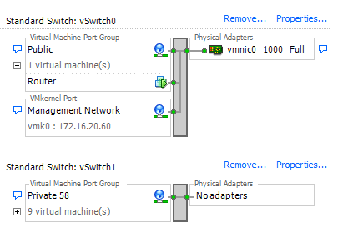
VMware vSphere 5.1
Networking: Private / “inside” subnet for NHV environment
Benefit = portable “pod”
Create two vSwitches:
  Physical network (Public)
  “Bubble” network (Private 58)
Use a VM NAT router / firewall for traffic to/from your guests.
  Demo using open-source Vyatta.

Slide 11
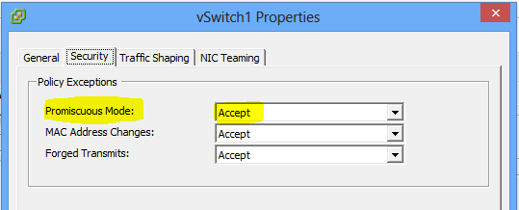
VMware vSphere 5.1
Networking: Promiscuous Mode
Enable Promiscuous Mode on host system / “physical” vSwitch
  Required for your nested VMs to have network connectivity
  See: http://kb.vmware.com/selfservice/microsites/search.do?cmd=displayKC&externalId=1002934

Slide 12
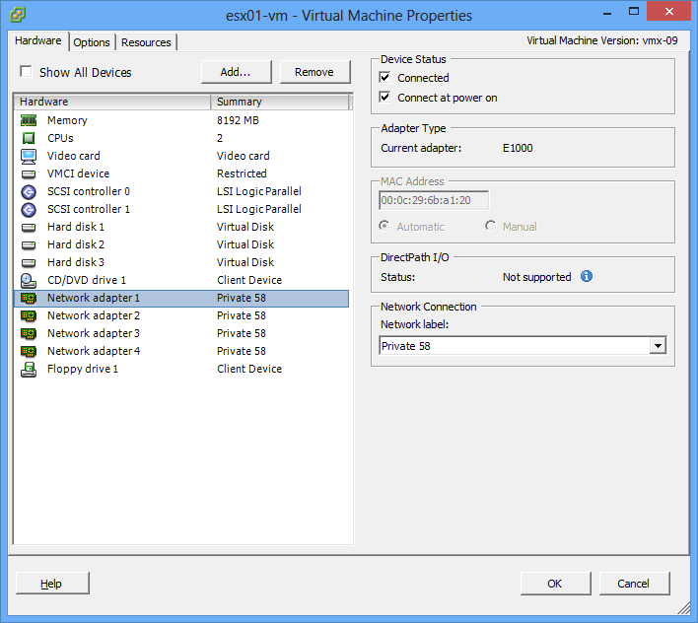
VMware vSphere 5.1
Network: Use E1000 Adapter for Nested vSphere host VMs!
VMXNet3 is somewhat experimental on vSphere Nested HV (i.e. psod)
Use E1000
Can still use VMXNet3 in Nested HV guests, if you want

Slide 13
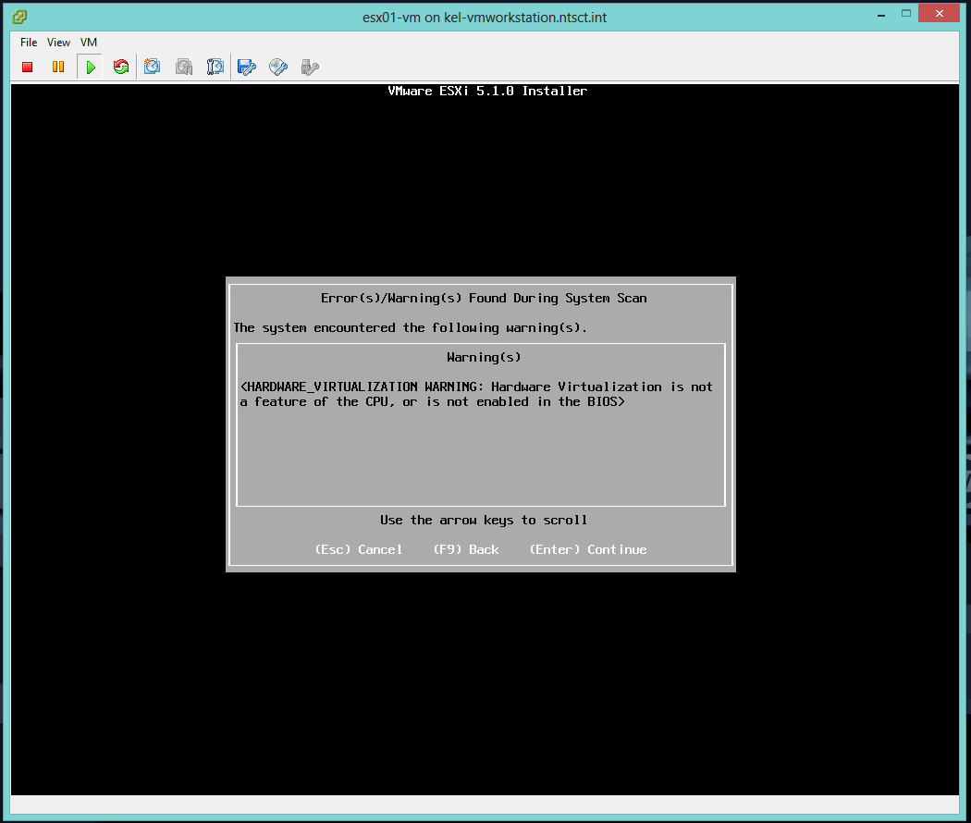
VMware vSphere 5.1
Installing Nested vSphere: Hit (Enter) to Continue!
This is normal! You can continue!
You must present 2 CPUs and 2GB of RAM to each host; you can cut back the CPU to 1 after the build. Memory must stay at at least 2GB.

Slide 14
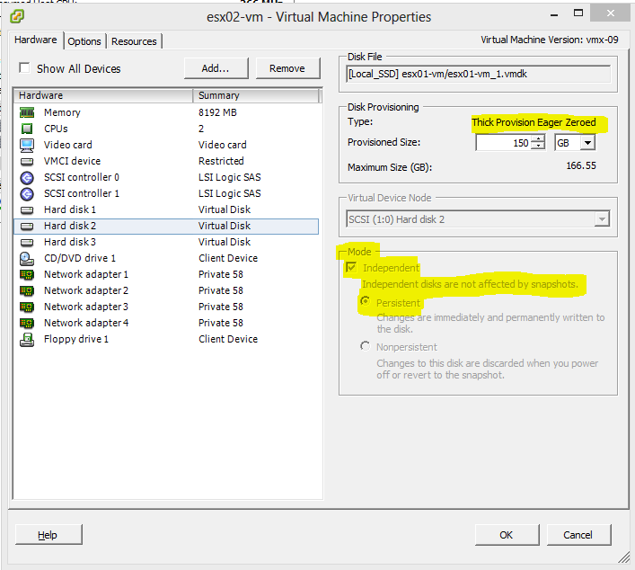
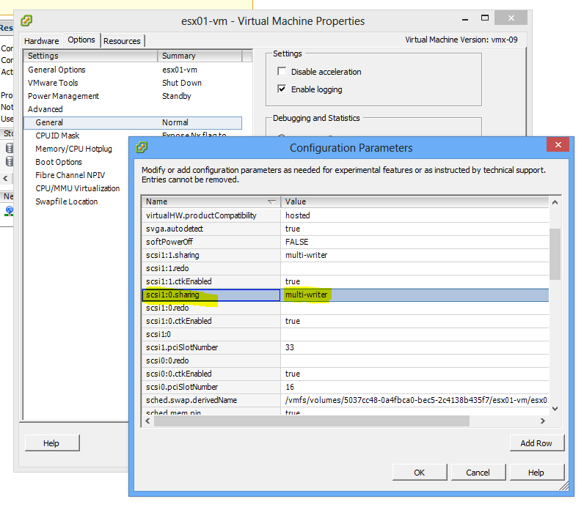
VMware vSphere 5.1
Shared Storage: VMware LSI Logic SAS!
VSA approach
  = Overhead on a slim environment
Shared SAS approach
  + No overhead
  Enable “multi-writer” / use with LSI Logic SAS
  http://kb.vmware.com/...externalId=1034165
Eager Zero Thick
Independent (you don’t want to snapshot these!)

Slide 15
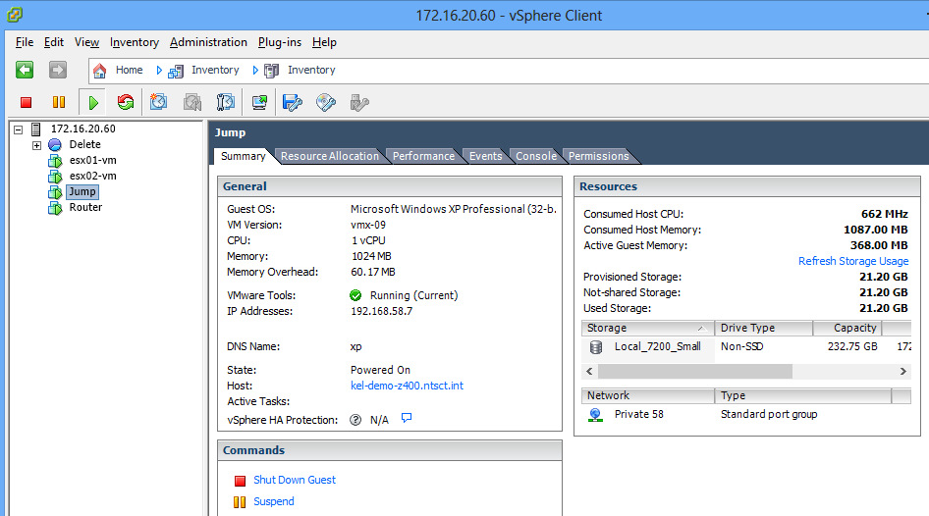
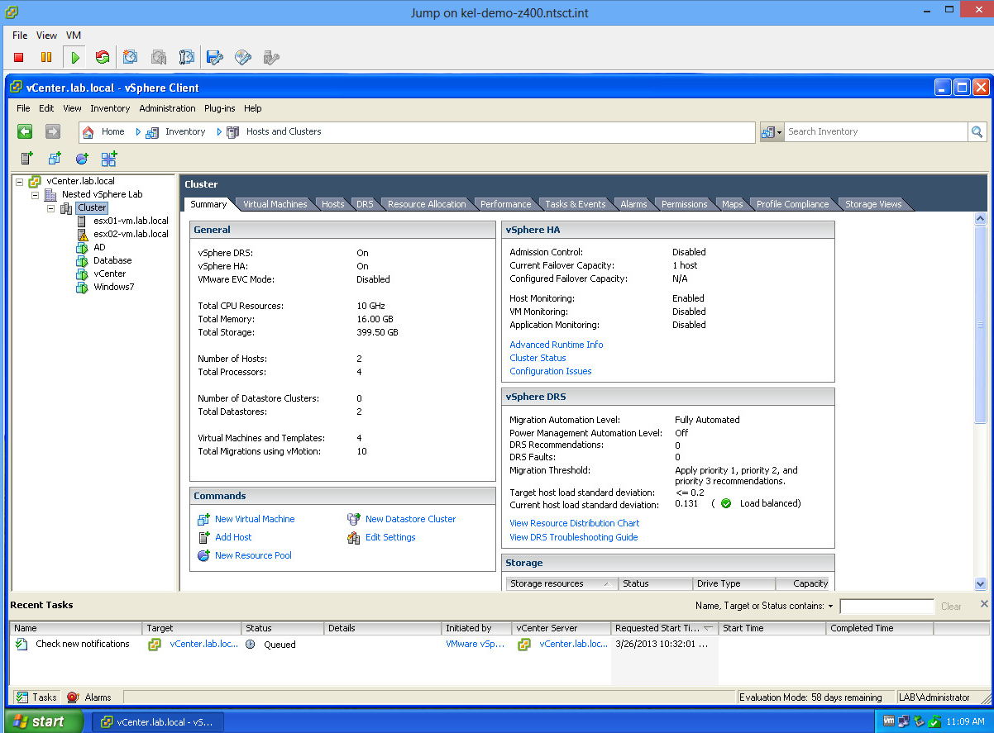
VMware vSphere 5.1
Build your VMs!
  #1 Access vSphere Client from “Jump” machine’s console / RDP
  #2 NAT translation to a VM “inside” the bubble network

Slide 16
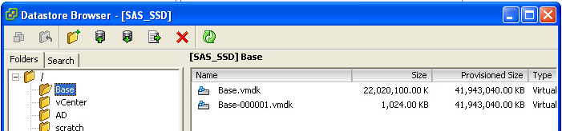
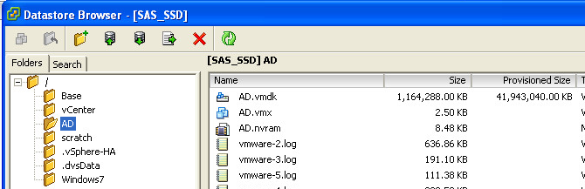
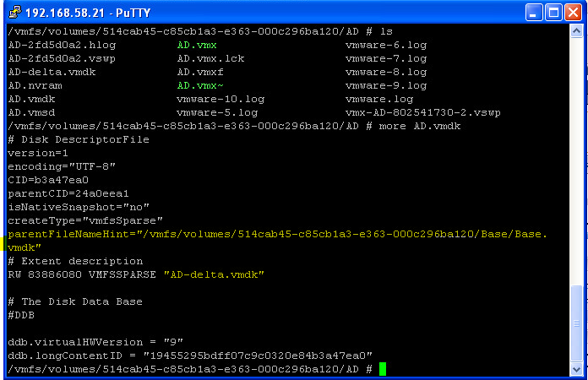
VMware vSphere 5.1
Shared Storage: SSD
Performance
Manual “Linked Clones”
  (Optional – save disk space on SSD. If you want to rename VMDK’s you will need to do that via SSH)
  #1 Build your “base”
  #2 Snapshot it
  #3 Copy that snapshot X number of times
  #4 Rename / Update -delta.vmdk files to reflect the parent image’s full path (kind of optional)
  #5 “Use Existing” when building your VMs and select the –delta.vmdk file you copied as the VMDK
The “base” is using 22GB and the “delta” for AD is using 1.16GB, so there is considerable advantage do doing this with SSD.
Be EXTREMELY careful with “Delete from Disk”, so you don’t delet the parent vmdk too!

Slide 17
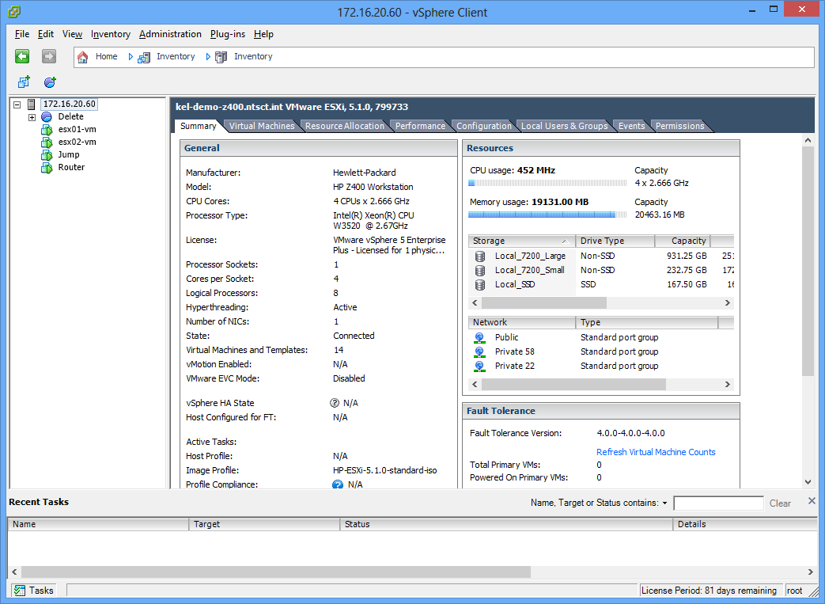
VMware vSphere 5.1
What it looks like: Host System

Slide 18
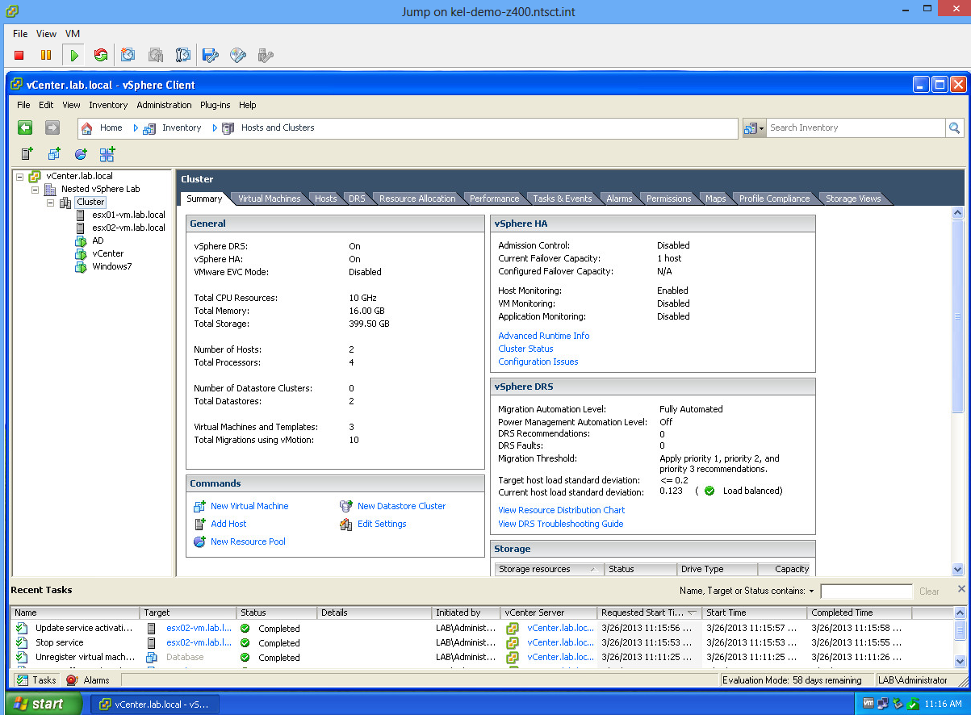
VMware vSphere 5.1
What it looks like: Nested vSphere Cluster

Slide 19
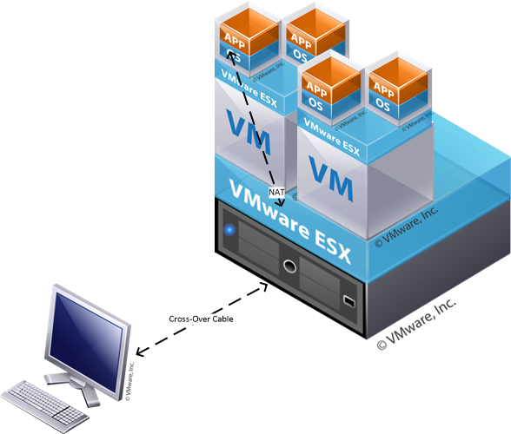
Live Demo
RDP from HP Thin-client to Windows 7 VM
hosted by nested vSphere
  Windows 7 VM has VMware Tools and
  no other optimizations
Setup:
  HP Thin-client w/ x-over cable to workstation
  HP Z400
    1 quad-core Intel Xeon Processor
    20GB RAM
    2 x 7200RPM SATA
    1 x 160GB Intel 520-series SSD
    1 x 5GB USB stick

